Slide 1
STUDENT PERFORMANCE MONITORING SYSTEM
CSE303: DATABASE MANAGEMENT
SYSTEM

Slide 2
GROUP 3
SHANAZ RAZIA FIDDA: 1731389
MD. TAREK AZIZ: 1730050
MD. ZAHIDUL ISLAM: 1721883
TOUFIQ AHMED NILOY: 1631281
BM FAHIM ABRAR: 1630263
SHAHNEWAZ MUHAMMAD RAJIT: 1630736
MAHFUZUR RAHMAN: 1811077

Slide 3
CONTENT
CHAPTER 1: INTRODUCTION
CHAPTER 2: REQUIREMENT ANALYSIS
RICH PICTURE (AS-IS)
SIX ELEMENTS (AS-IS)
PROCESS DIAGRAM (AS-IS)
PROBLEM ANALYSIS
RICH PICTURE (TO-BE)
SIX ELEMENTS (TO-BE)
PROCESS DIAGRAM (TO-BE)
CHAPTER 3: LOGICAL SYSTEM DESIGN
BUSINESS RULE
ENTITY RELATIONSHIP DIAGRAM
ENTITY RELATIONSHIP DIAGRAM TO RELATIONAL SCHEMA
NORMALIZATION
DATA DICTIONARY
CHAPTER 4: PHYSICAL SYSTEM DESIGN
INPUT FORMS
OUTPUT FORMS
CHAPTER 5: CONCLUSION

Slide 4
Chapter 1: Introduction
Our goal is to deliver a project that will design and build to help universities to promote a productive way for student performance monitoring system. We intend to provide a wholesome experience for students, faculties, head of departments and all the higher authorities. This application is a one-stop place for students to track their progress, for faculties to track course curriculum and all the higher authorities to monitor quality of education provided. We have added features to track students CGPA trend and sleeker way of workflow. This application gives the power to generate new student accounts much faster

Slide 5
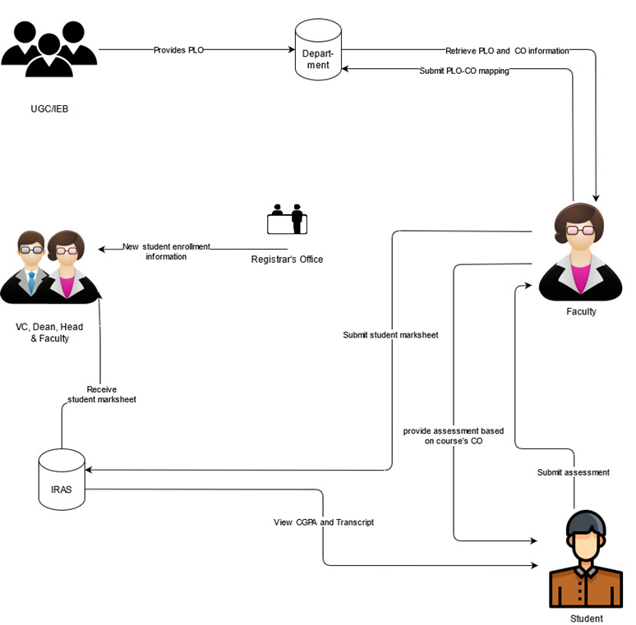
RICH PICTURE (AS-IS)
Figure: Rich Picture As-Is

Slide 6
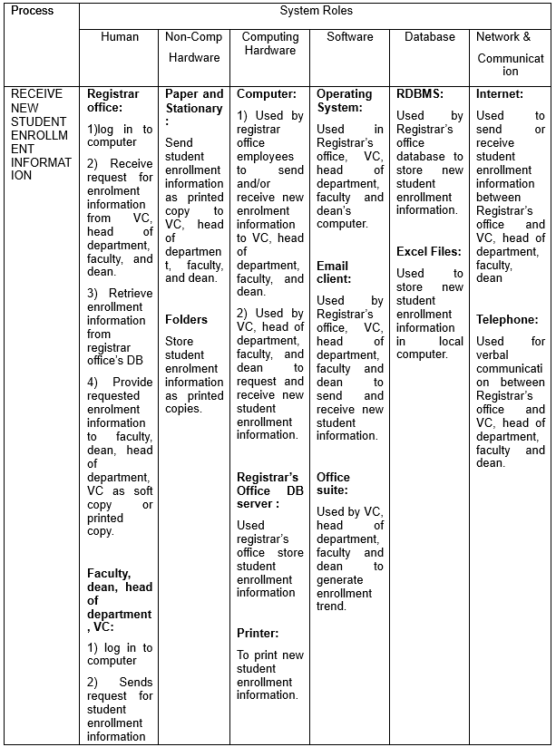
SIX ELEMENTS (AS-IS)

Slide 7
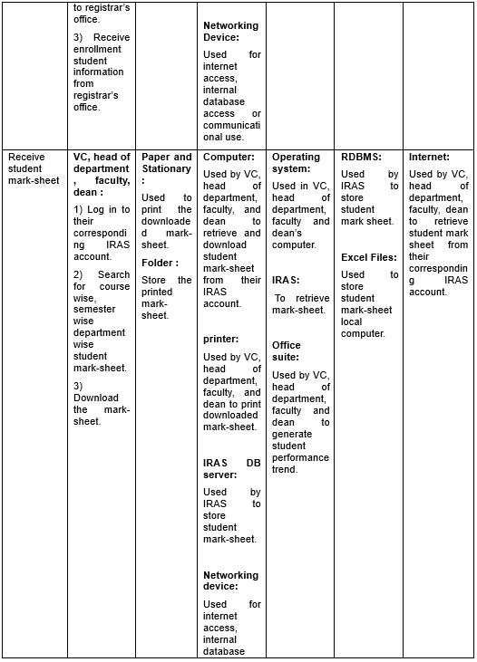

Slide 8
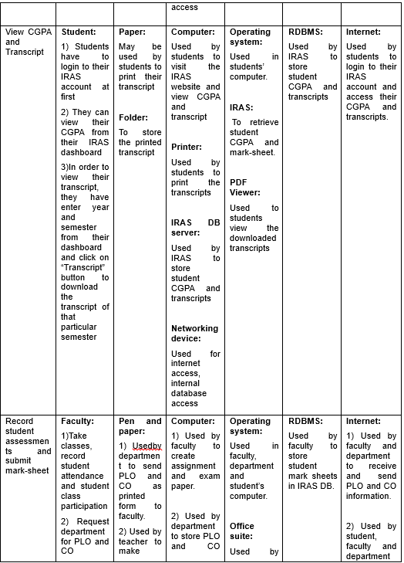

Slide 9
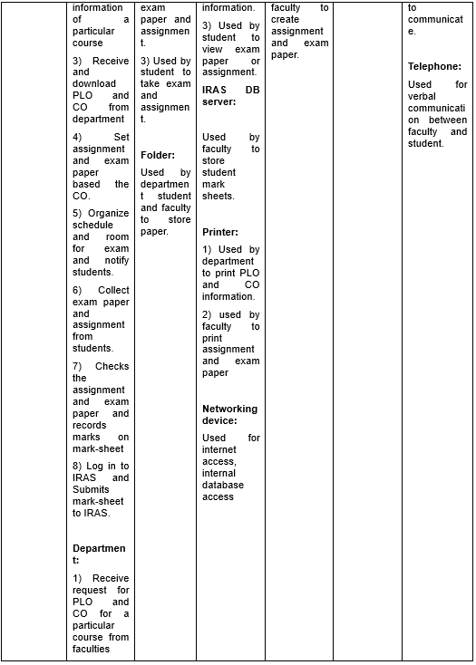

Slide 10
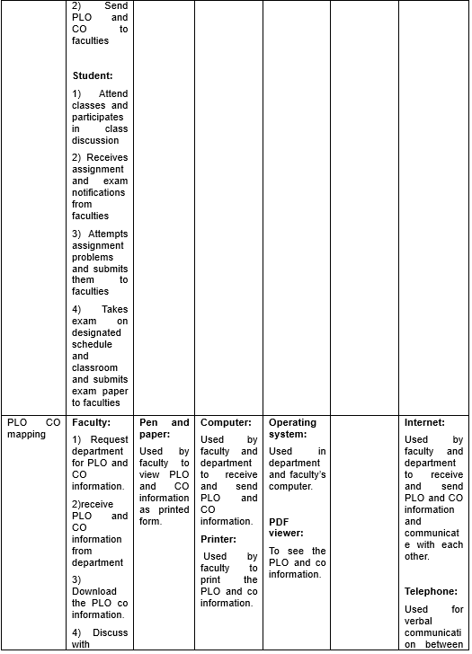

Slide 11
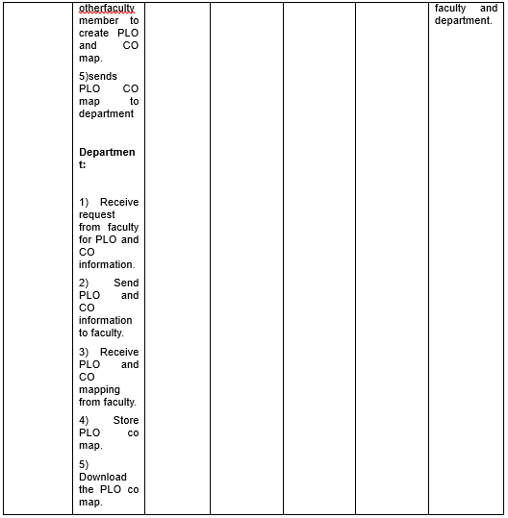

Slide 12
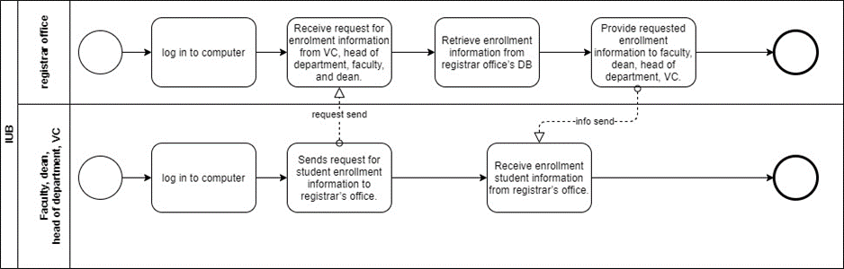
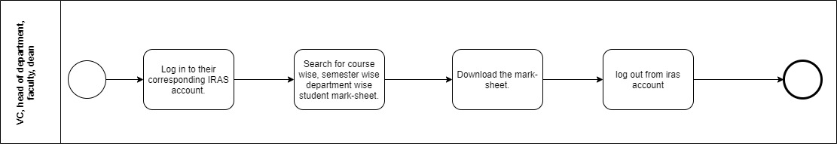
BUSINESS PROCESS DIAGRAM (AS-IS)
BPMN (AS-IS) FIGURE 1: View new enrollment data
BPMN (AS-IS) FIGURE 2: View Student Mark-sheet by VC, Dean, Head, and Faculty

Slide 13
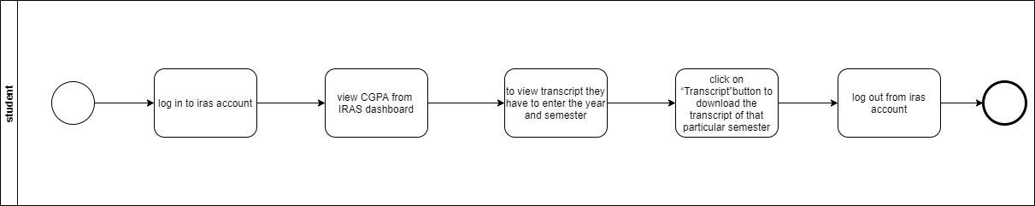
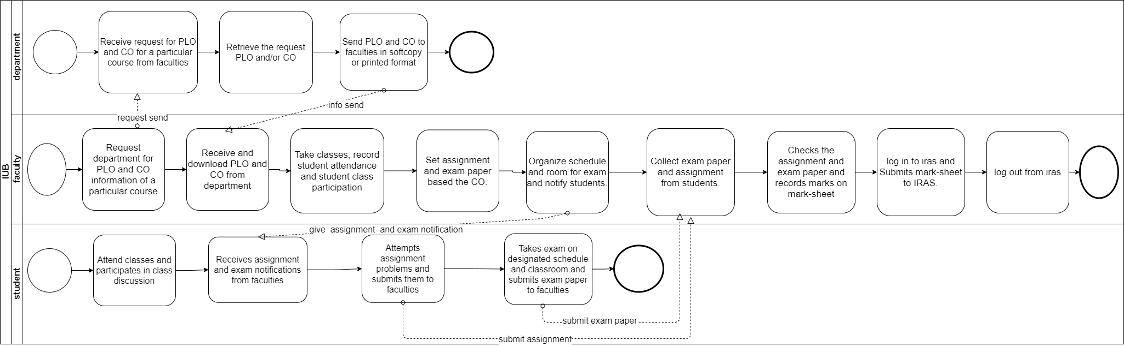
BPMN (AS-IS) FIGURE 3: View Transcript by Students
BPMN (AS-IS) FIGURE 4: Record Student Assessment

Slide 14
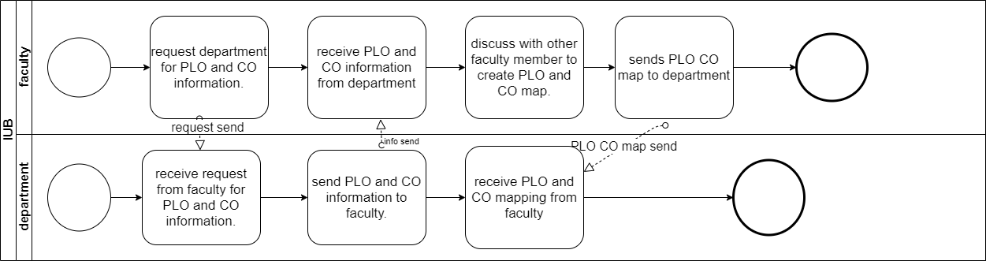
BPMN (AS-IS) FIGURE 5: Map PLO to CO

Slide 15
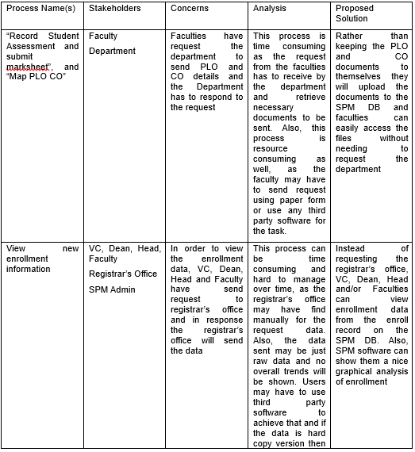
PROBLEM ANALYSIS

Slide 16
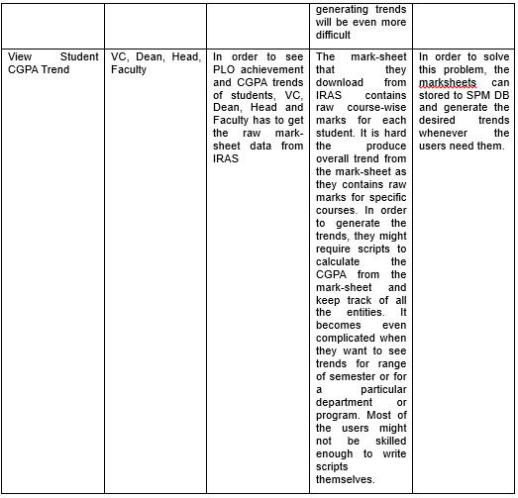

Slide 17
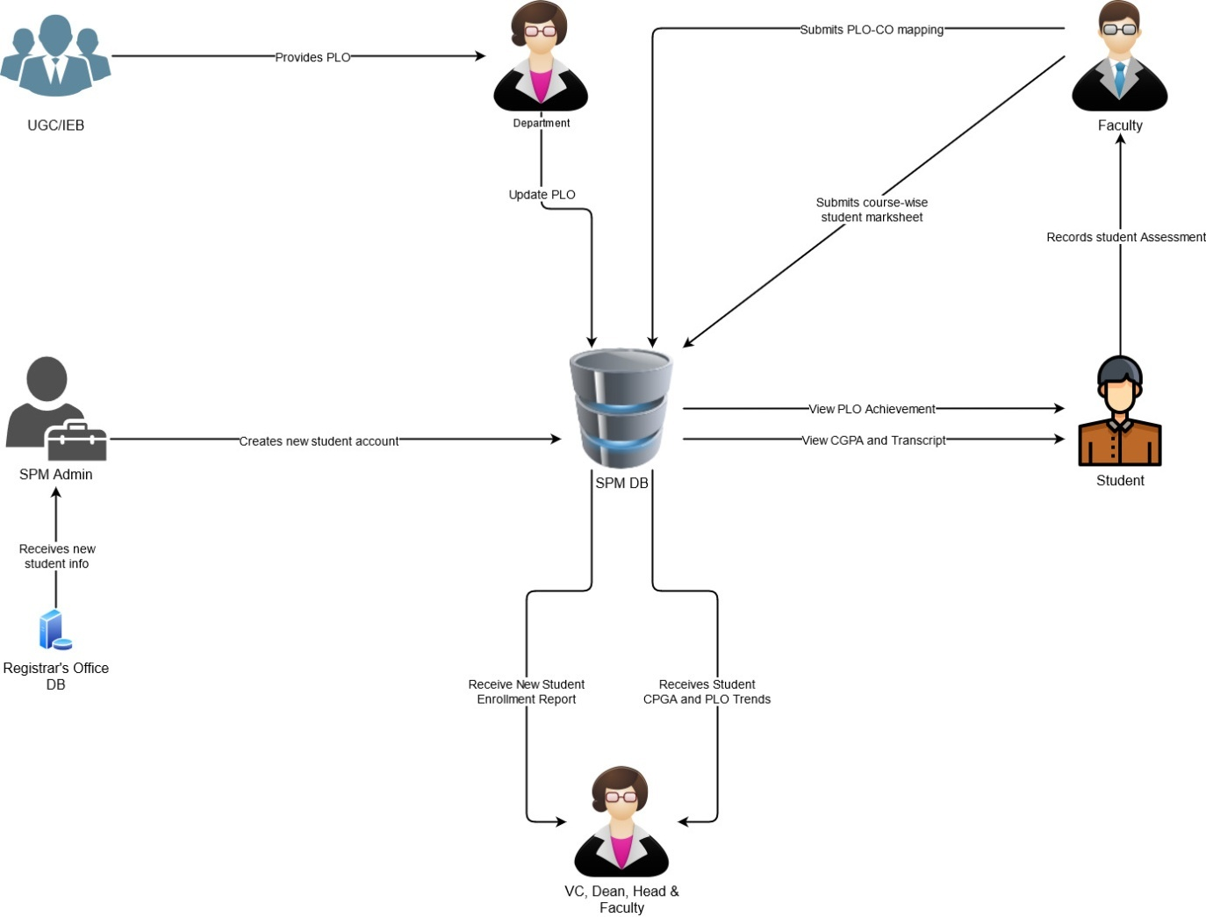
RICH PICTURE (TO-BE)
Figure: Rich Picture TO-BE

Slide 18
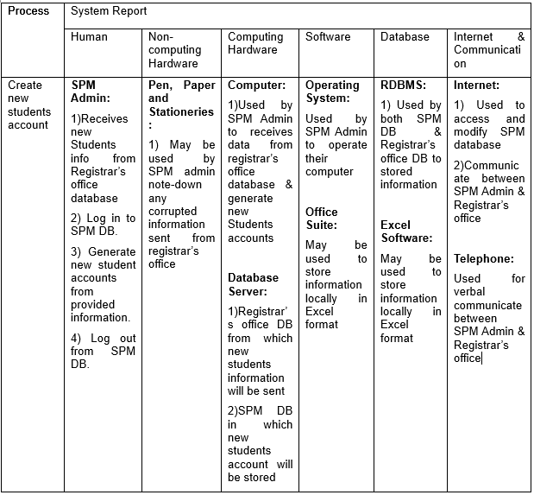
SIX ELEMENT ANALYSIS (TO-BE)

Slide 19
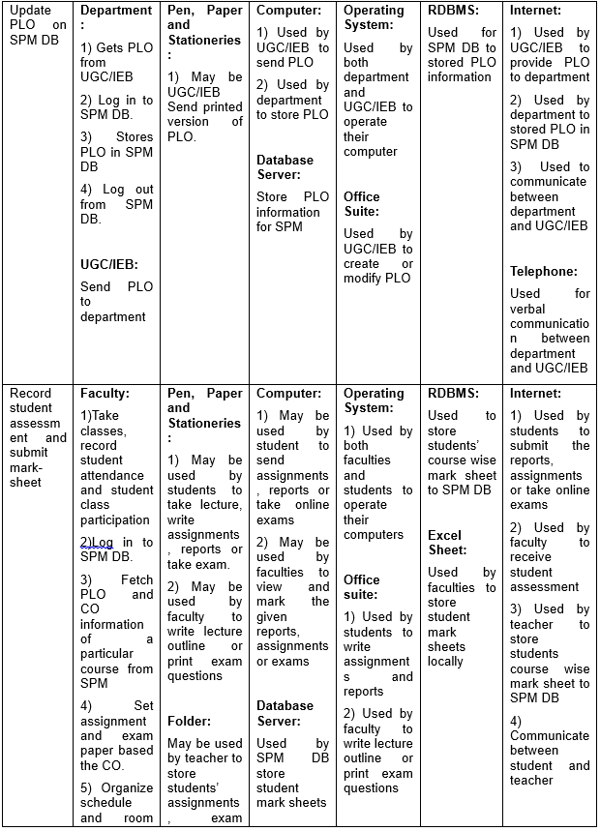

Slide 20
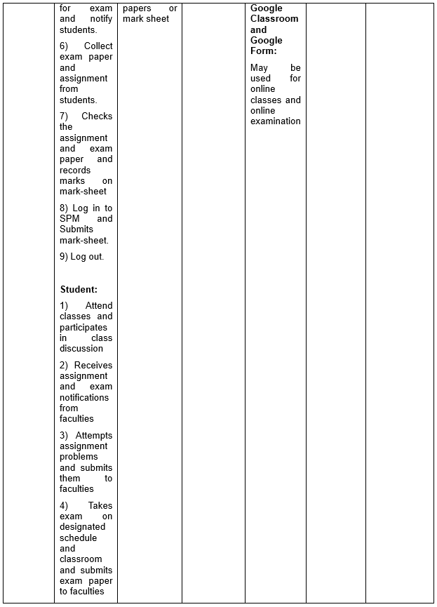

Slide 21
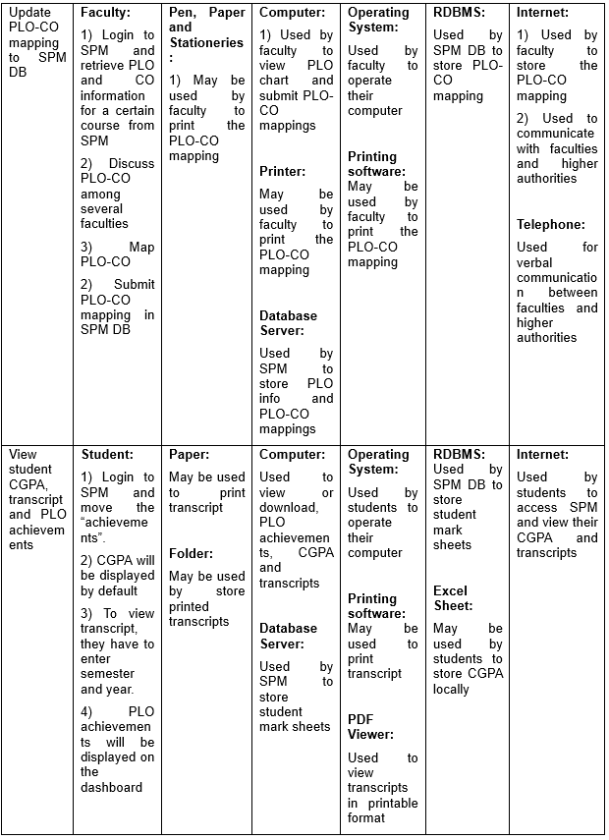

Slide 22
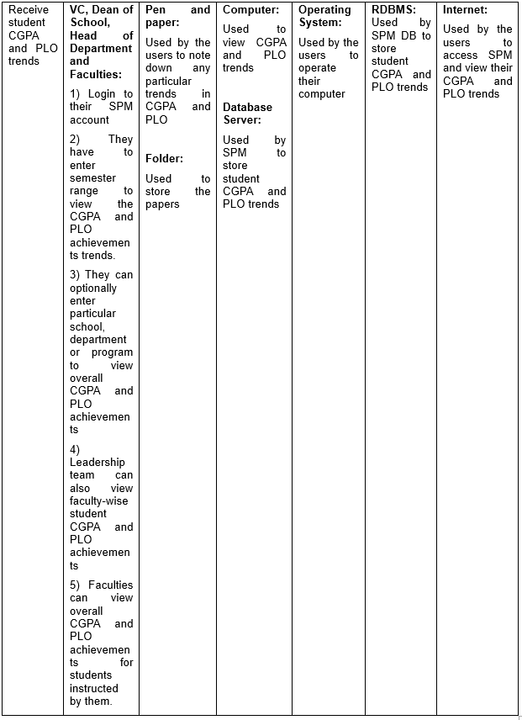

Slide 23
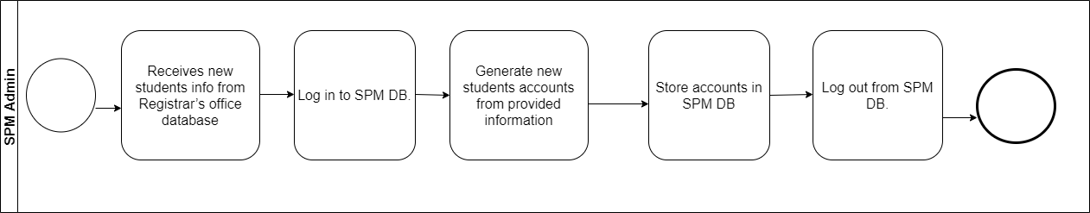
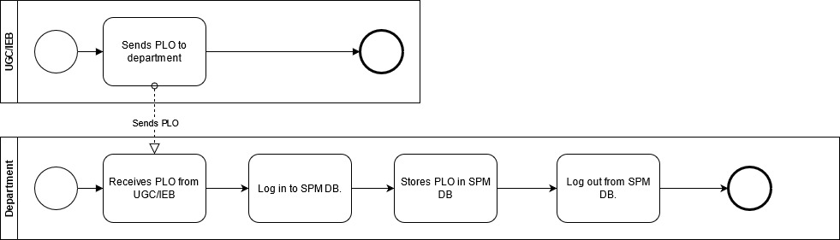
BUSINESS PROCESS DIAGRAM (TO-BE)
BPMN (TO-BE) FIGURE 1: Create new student account
BPMN (TO-BE) FIGURE 2: Update PLO on SPM DB

Slide 24
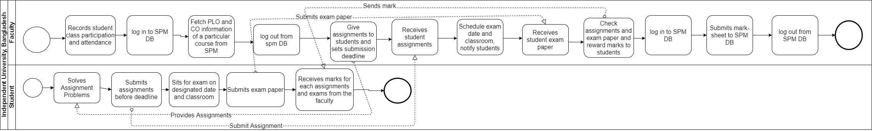
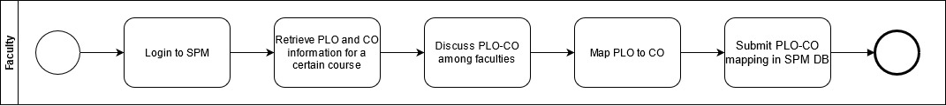
BPMN (TO-BE) FIGURE 3: Record student assessment and submit mark-sheet
BPMN (TO-BE) FIGURE 4: Update PLO-CO mapping to SPM DB

Slide 25
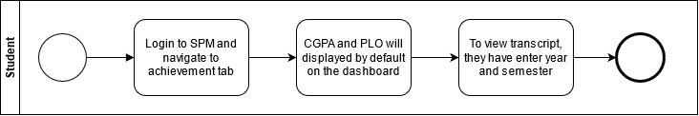
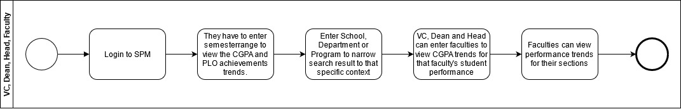
BPMN (TO-BE) FIGURE 5: View student CGPA, transcript and PLO achievements
BPMN (TO-BE) FIGURE 6: Receive student CGPA and PLO trends

Slide 26
CHAPTER 3: LOGICAL SYSTEM DESIGN
BUSINESS RULE
ENTITY RELATIONSHIP DIAGRAM
ENTITY RELATIONSHIP DIAGRAM TO RELATIONAL SCHEMA
NORMALIZATION
DATA DICTIONARY

Slide 27
Business Rule
A university must assign many employee. Each employee is assigned by exactly one university. A university must consist of many school. Each school is belongs to exactly one university.
An employee can be faculty or VC. And a faculty can be dean of school or department head.
A university must assign exactly one VC. Each VC is assigned by exactly one university. A faculty must assign to a section. Each section must have a faculty. A department must employee many faculty. Each faculty is employed by exactly one department. a semester must consist of many faculty. Each faculty is assigned to exactly one semester. A dean of school is belongs to exactly one school. Each school must have exactly one dean of school. A department head is belongs to exactly one department. each department must have exactly one department head.
A school is consist of many department. each department must belongs to exactly one school.
A department must enrolls many student. Each student is enrolled by exactly one department. a department is consist of many program. Each program must belongs to exactly one department.
A program must enrolls many student. Each student is enrolled by exactly one program. A program must provide many course. Each course is provided by exactly one program. A program is consist of many plo. Each plo is contain by exactly one program.
A semester must contain many student. Each student enrolled to exactly one semester. A semester must contain many courses. Each course is assign to exactly one semester. A semester must consist of many section. Each section is assign to exactly one semester.
A course is consist of many cos. Each co belongs to exactly one course. A course is assign to many sections. Each section assigned by exactly one course.
A assessment must provide many assessment submission. A assessment submission is provided by exactly one assessment. A section may assign many assessment. Each assessment is assigned by exactly one section.
A student may submit many assessment submission. Each assessment submission is submitted by exactly one student.
A plo must have many cos. Each co is belongs to exactly one plo.
A co must have many assessment. Each assessment is belongs to exactly one co.

Slide 28
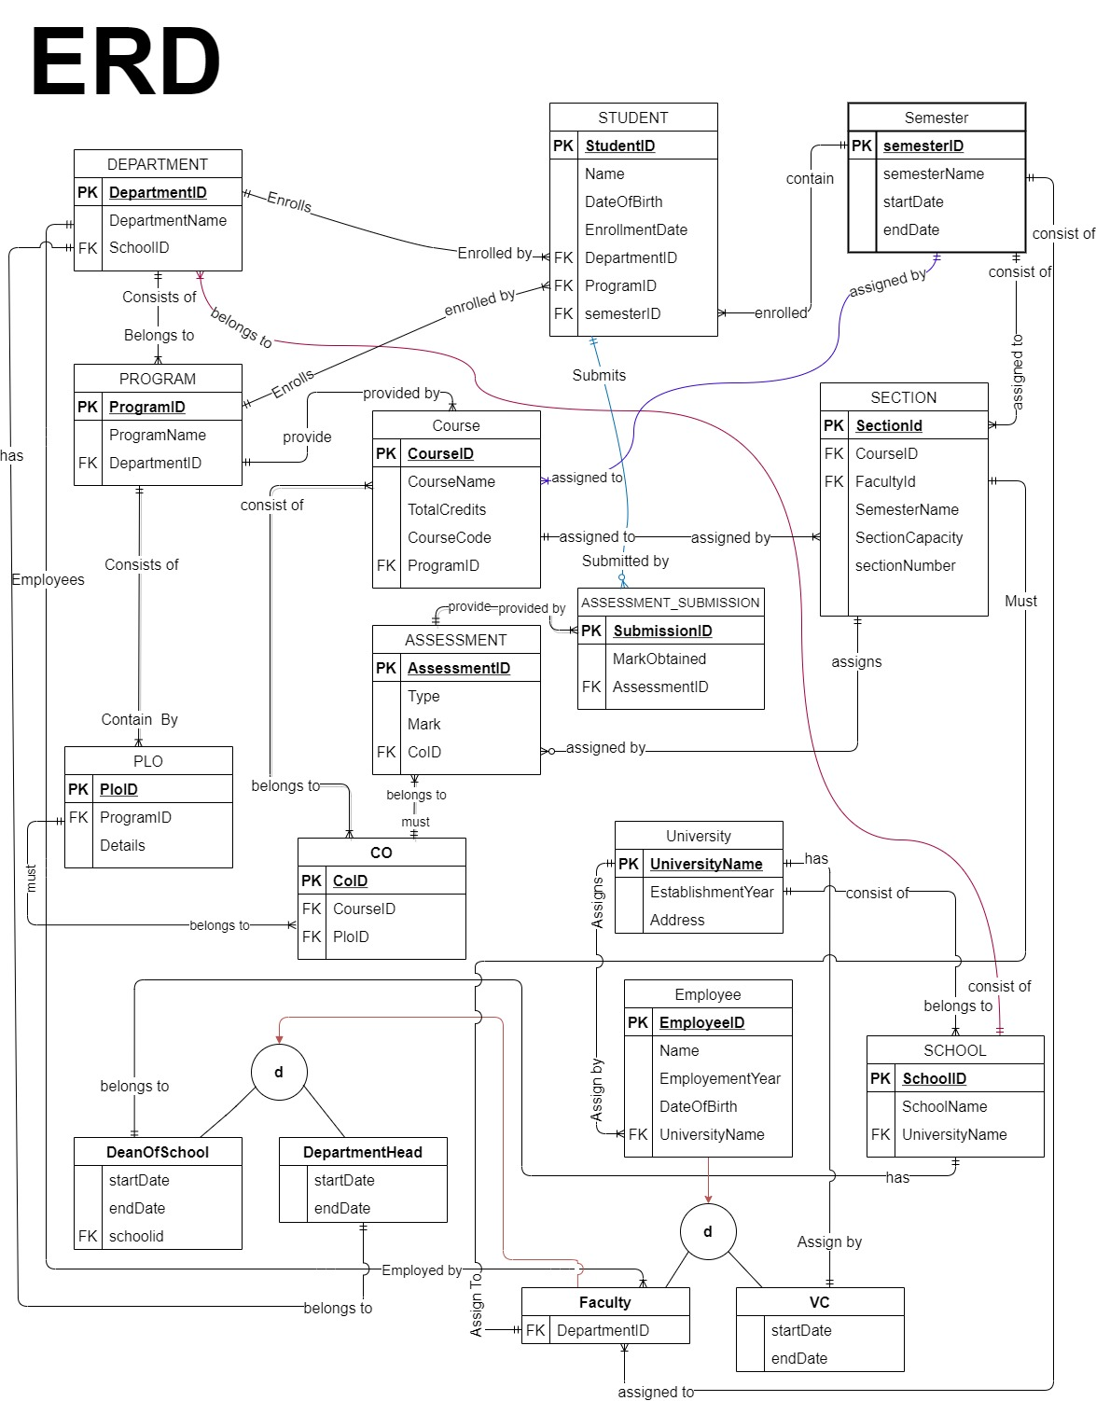

Slide 29
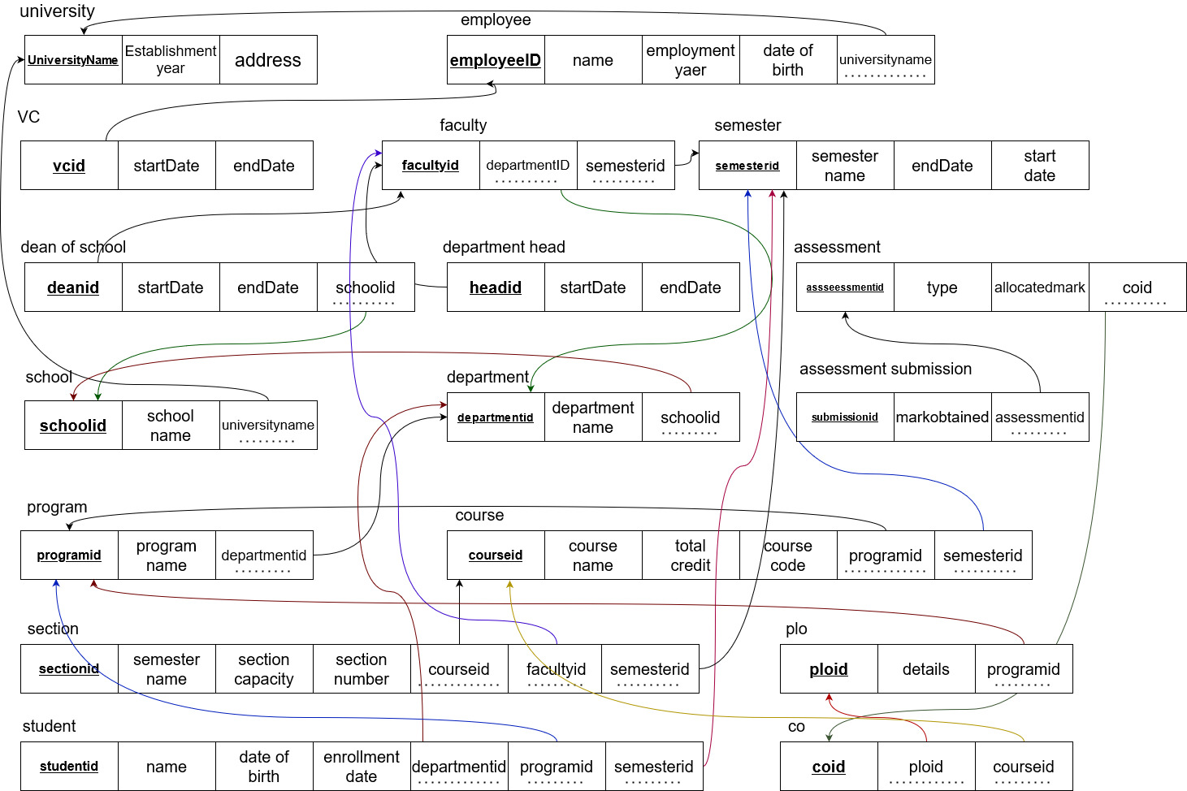
RELATIONAL SCHEMA

Slide 30
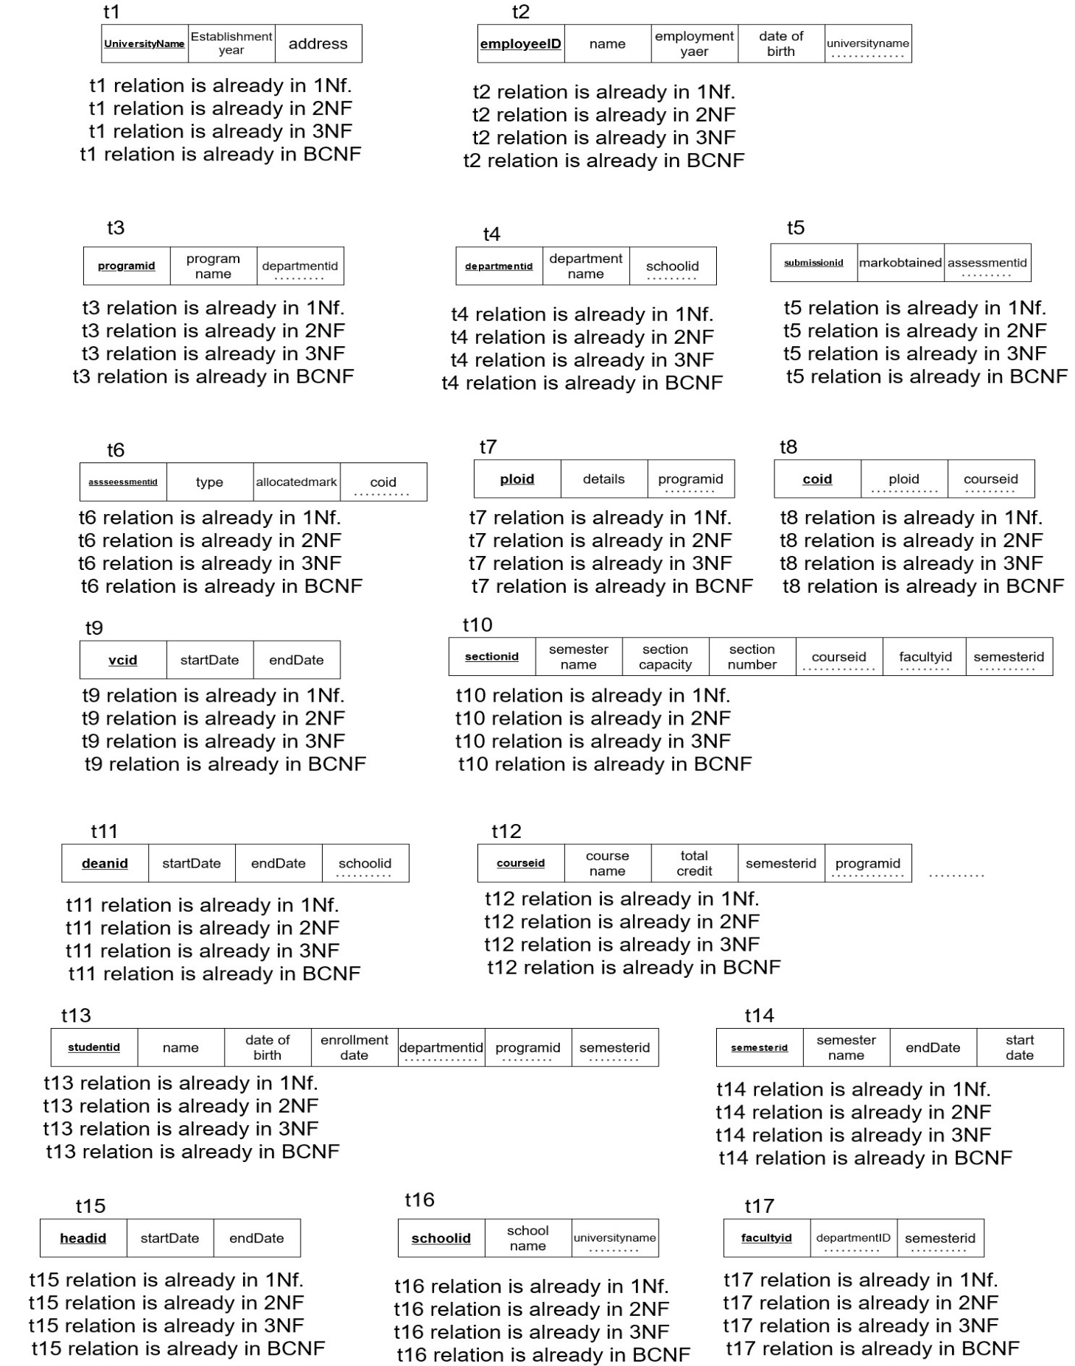
NORMALIZATION

Slide 31
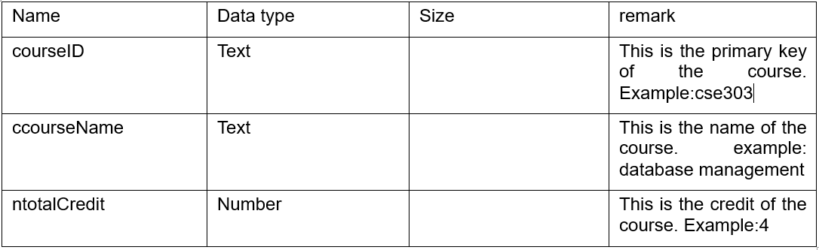
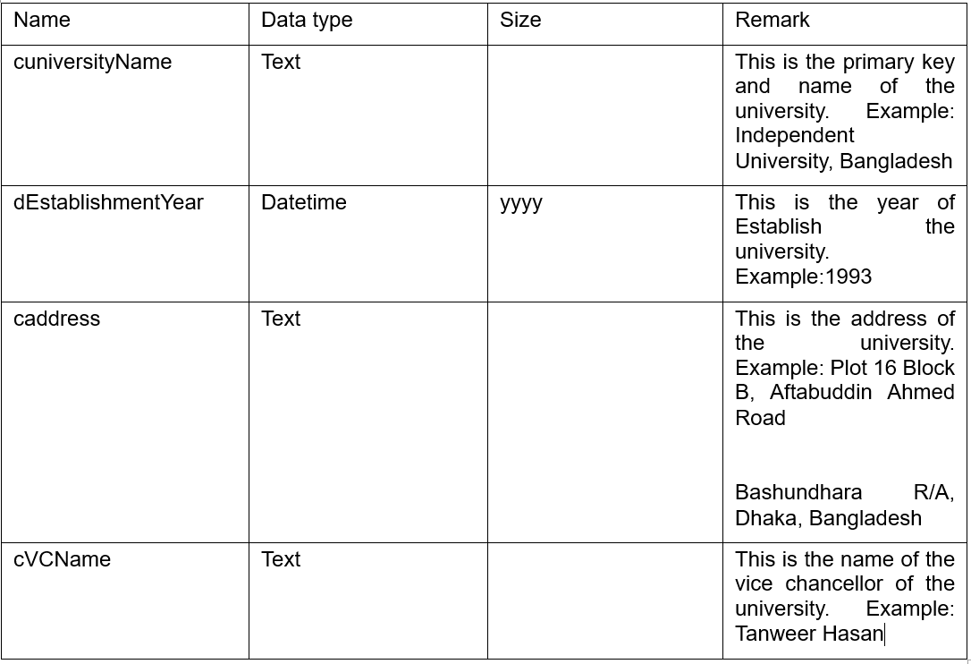
DATA DICTONARY:
tblcourse
tbluniversity

Slide 32
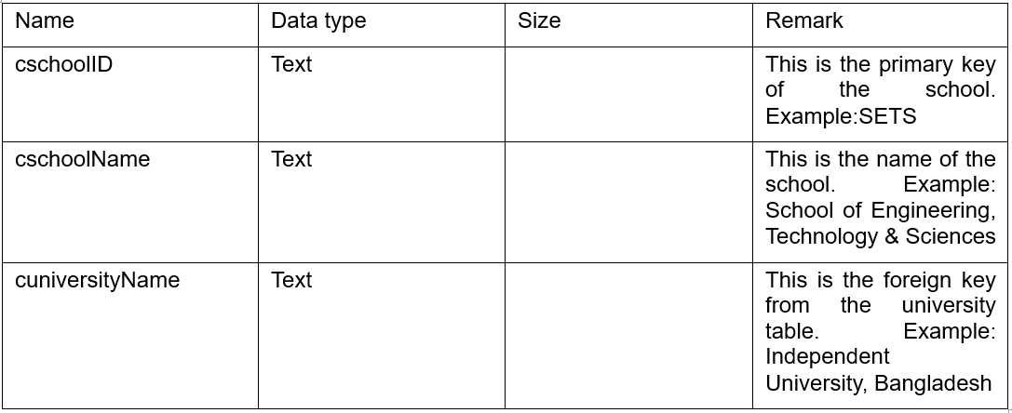
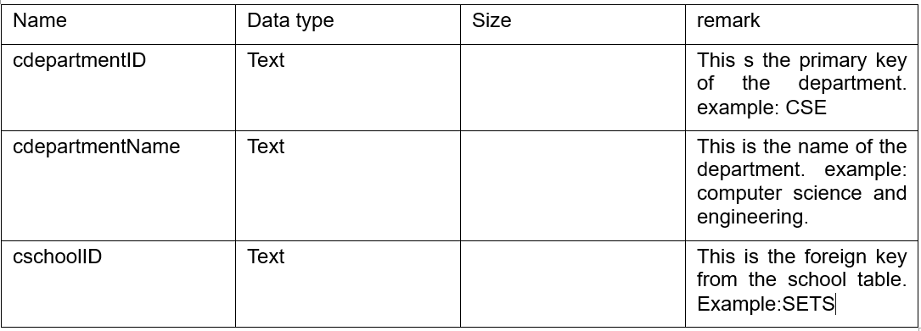
tblschool
tbldepartment

Slide 33
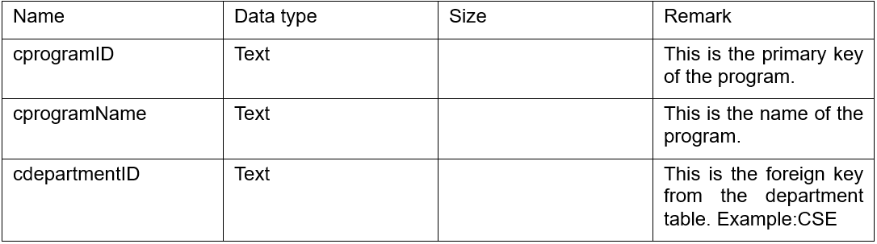
tblprogram

Slide 34
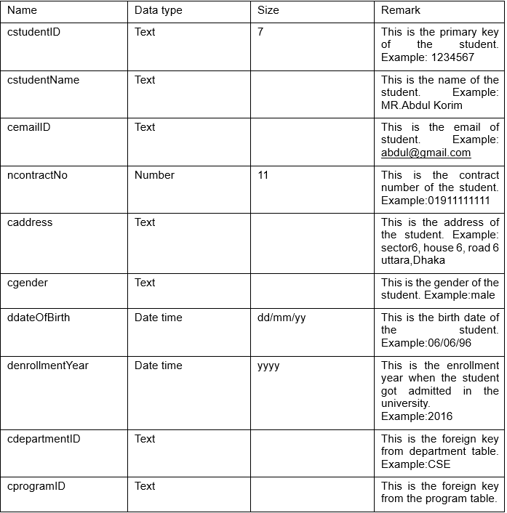
tblstudent

Slide 35
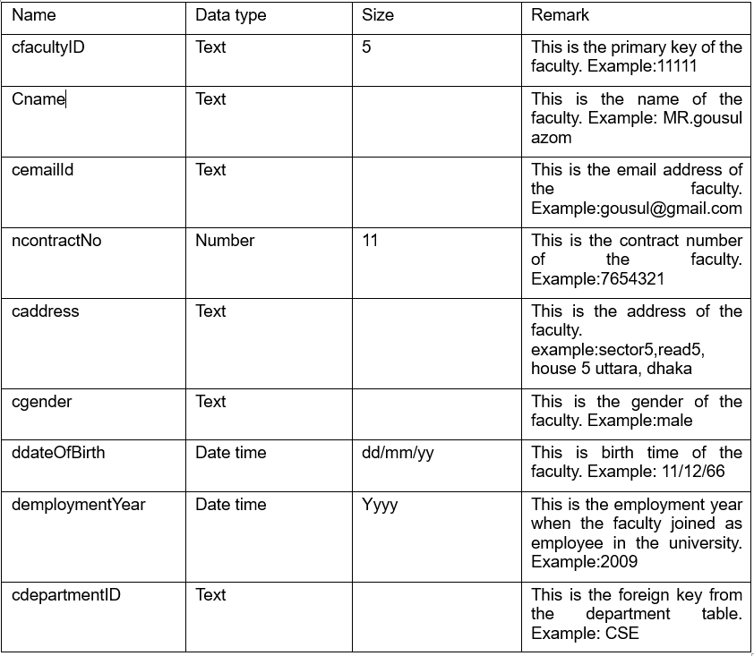
tblfaculty

Slide 36
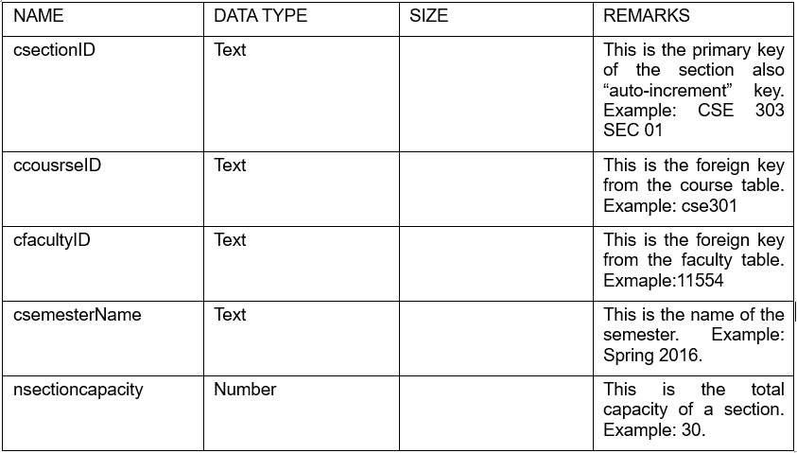
tblsection

Slide 37
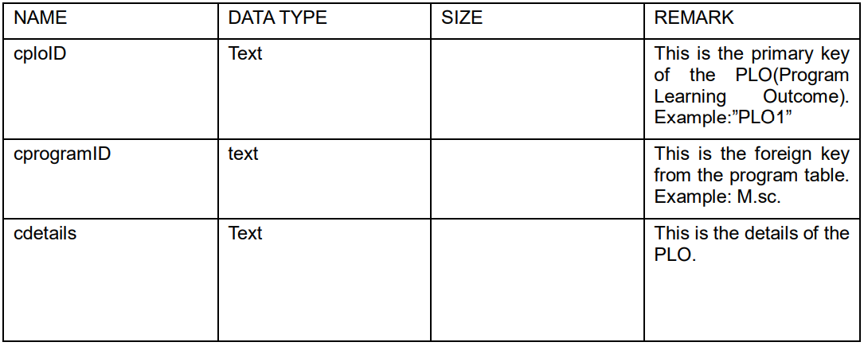
tblplo

Slide 38
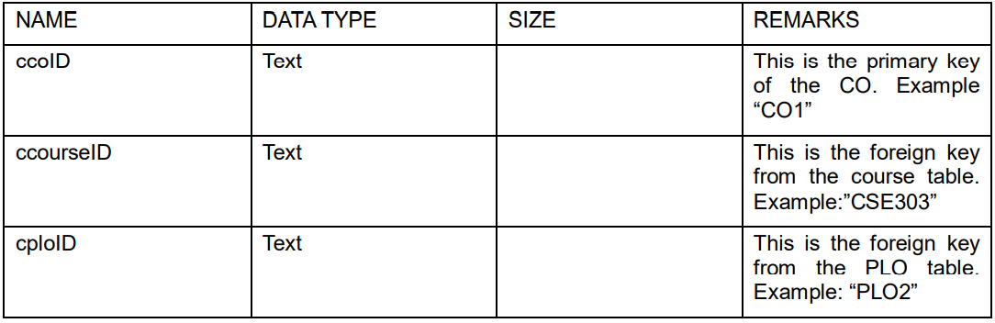
tblco

Slide 39
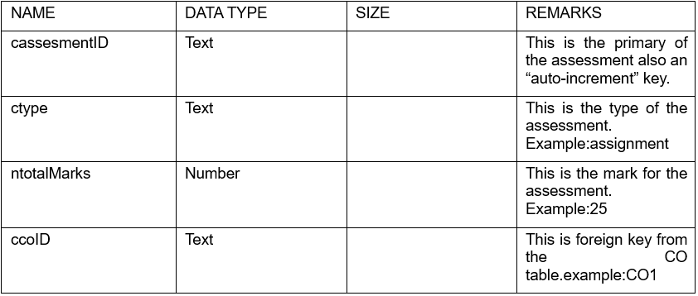
tblassessmentID

Slide 40
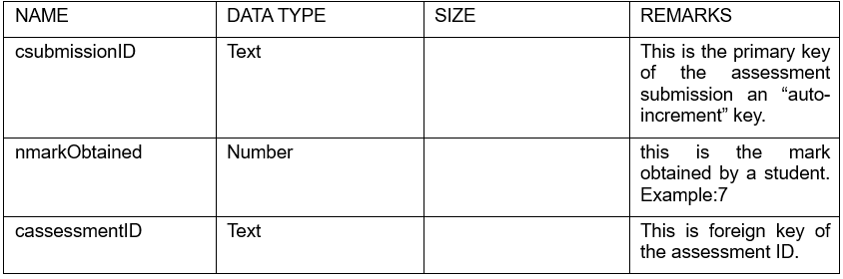
tblassessment submission

Slide 41
CHAPTER 4: PHYSICAL SYSTEM DESIGN
INPUT FORMS
OUTPUT FORMS

Slide 42
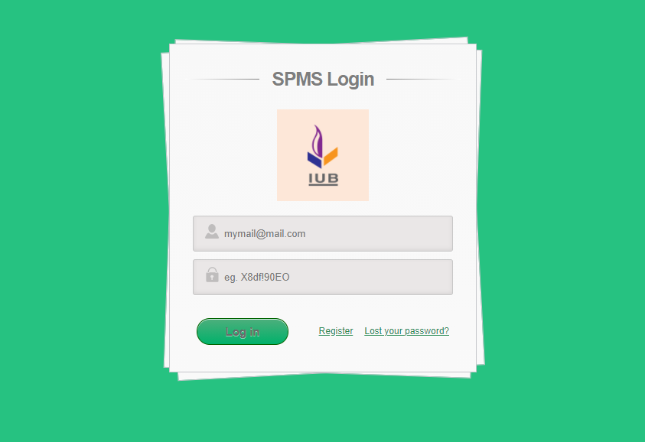
LOGIN INTERFACE

Slide 43
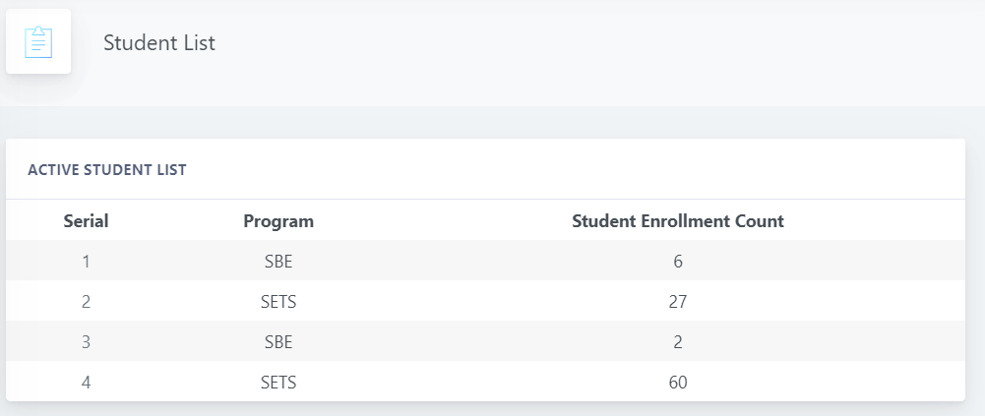
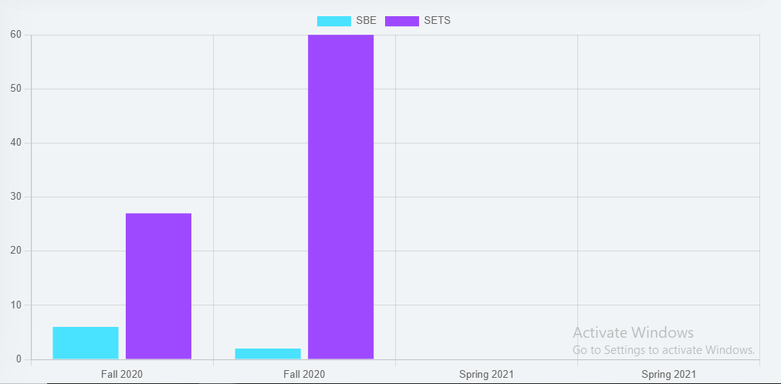
School-Wise Student enrollment comparison

Slide 44
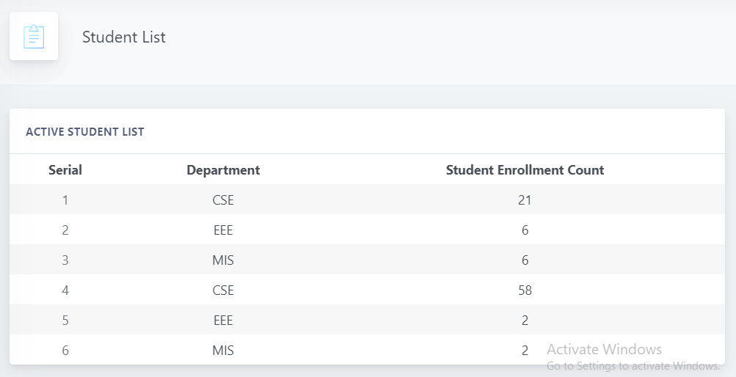
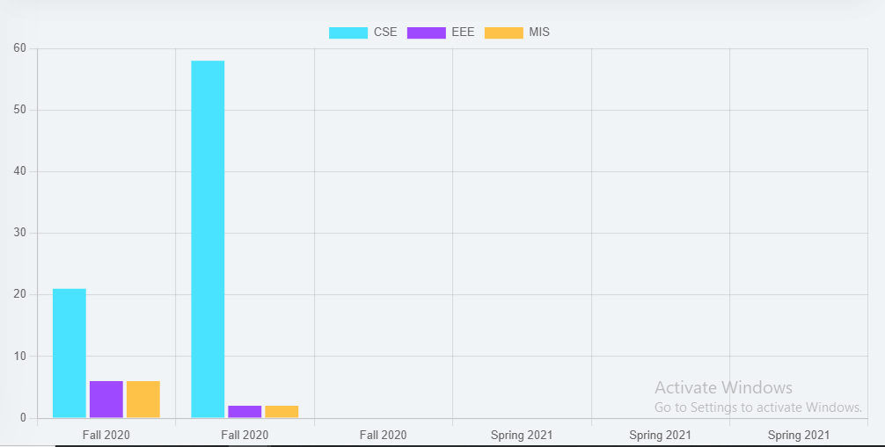
Department-Wise Student enrollment comparison

Slide 45
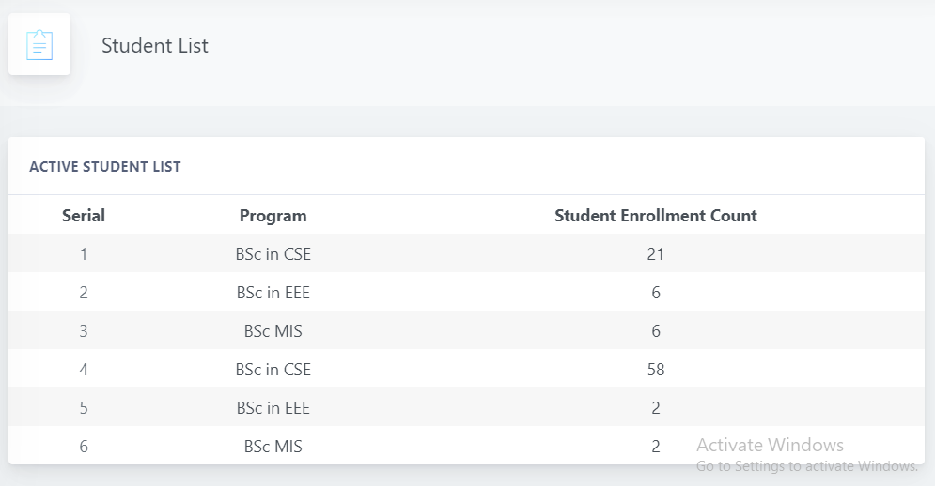
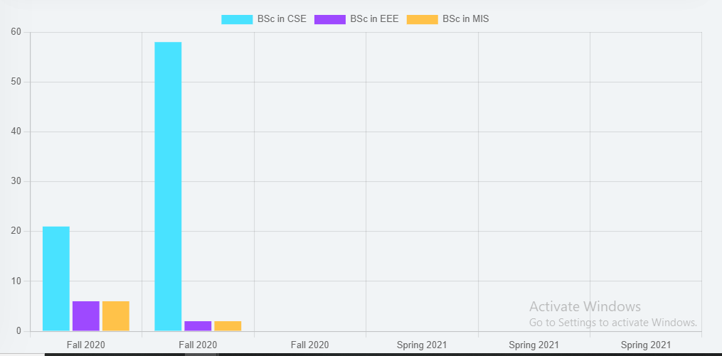
Program-Wise Student enrollment comparison

Slide 46
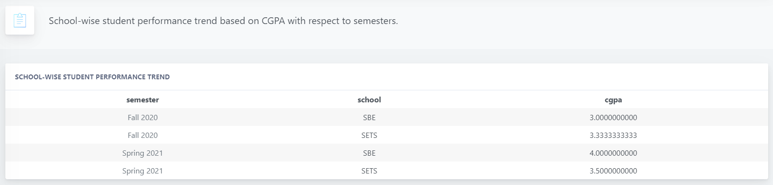
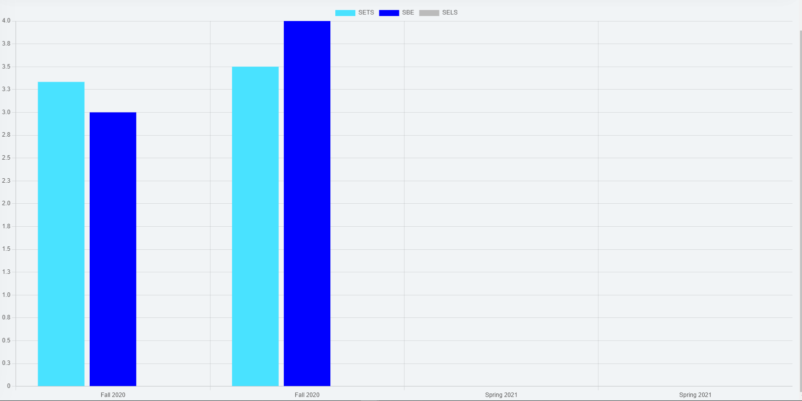

Slide 47



Slide 48



Slide 49


Slide 50



Slide 51



Slide 52

ANALYTICS DASHBOARD

Slide 53

USER PROFILE

Slide 54

STUDENT MARKSHEET

Slide 55
CHAPTER 5
CONCLUSION

Slide 56
Problem & Solution
When drawing the Rich Picture, we had to face the challenge of keeping the sequence in the right order.
Had to take decisions on groups meetings for the BCNF part in Normalizations as we were not sure that it will exist or not.
We used draw.io for BPMN and had difficulties understanding the sequence.
When creating the database, we had to find the exact entity and attributes but we were not sure to include it from our report that we already created or the project templates which had been provided. We still have confusions in this specific part but we think it is perfect as the project template is only for data entry and our report is based on overall SPEMS system...
We had problems understanding the exact relation for the Entity in ERD. We had to go through our class sides to get an idea.

